Slide 1
Agriculture Produce Analysis.
By Tochukwu Emmanuel.

Slide 2
Introduction:
This analysis transcends relationships between agricultural produce of some series of crops, temperature, amount of rainfall,the quantity and amount generated by each crop in specific regions per time.
Tools used: MS EXCEL/ GOOGLE SHEET
Source of data: Genesys upskill cohort 2 “ travel data sets”
Instructions : https://drive.google.com/file/d/1mHgTqcThtS2CQ6yd6VTnBhTdM-LfDA3o/view?usp=sharing

Slide 3
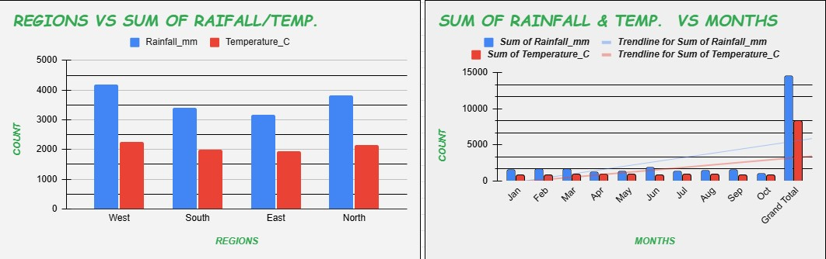
VISUALIZATIONS:

Slide 4
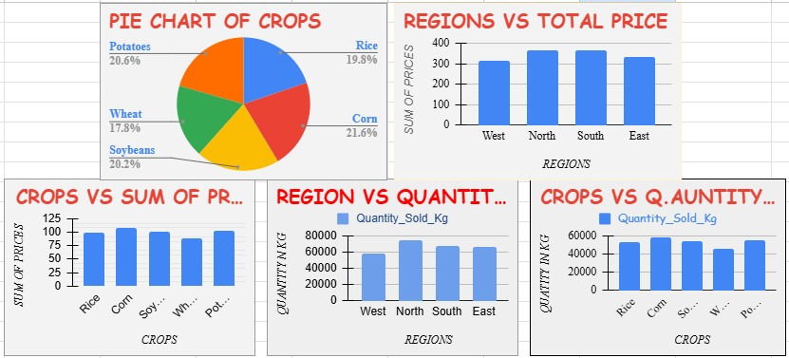

Slide 5
INSIGHTS AND RECOMMENDATION:
There is higher rainfall and temperatures in the West followed by North, South and then East with lowest rainfall and temperature. However, crops that its optimum growth is higher temperature and rainfall should be planted in the appropriate region as revealed.
Quantities sold and revenue in the northern and southern regions are slightly higher compared to the quantities sold in other regions. This could be as a result of easier means transportation or the demand being equivalent to supply as result of population differences.
Corn, potatoes, soybeans, rice and wheat are the descending order of revenues and quantity sold in “KG” of crops. However, More investments should be made to increase general yield and outputs.

Slide 6
PROPOSAL FOR WEB DEVELOPMENT:
Create a website/app with the following features:
A page about the venture and their farm products such as rice, wheat, maize, potato, soybeans etc they sell and prices per quantity/kilogram of each product.
A section where distributors can register as distributors with condition of minimum order amount on each major product.
Several continuous popup notification on the health benefits of the product they sell.
List of all their branches in the country.
Showcase of purchase history of each distributor and top 5 distributors by purchase (without showing the amount/quantity of their purchase)
The companies delivery time should also be shown to the distributors in the platform.
Vision and mission statements of the company should also be recorded.
Other necessities in the platform inview by the developers and designers.

Slide 7
The spreadsheets:
AGRIC WEATHER 2
AGRICULTURE 1
THANK YOU!

